Slide 1
Employee Performance Analysis Using Excel
PRESENTED BY: SOWMIYA LAKSHMI B
REGISTER NO: 312204631
DEPARTMENT: COMMERCE
COLLEGE: K.C.S KASI NADAR COLLEGE AND ARTS AND SCIENCE

Slide 2
PROJECT TITLE
Employee Performance Analysis Using Excel

Slide 3
AGENDA
1.Problem Statement
2. Project Overview
3.End Users
4.Our Solution and Proposition
5. Dataset Description
6. Modelling Approach
7. Results and Discussion
8.Conclusion

Slide 4
PROBLEM STATEMENT
CALCULATE THE OVERALL PERFORMANCE DISTRIBUTION:
Determine the percentage of total scores that fall into each performance category (Exceeds, Fully Meets, Needs Improvement).
IDENTIFY HIGH PERFORMERS:
List the employees who scored exclusively in the "Exceeds" category and calculate their combined total score.
COMPARE PERFORMANCE:
Compare the total scores for each category and identify which category has the highest total score and which has the lowest.
ANALYZE EMPLOYEE SCORES:
Determine which employee has the highest total score and which has the lowest total score, and provide their corresponding category breakdown.
CHECK DATA CONSISTENCY:
Verify that the sum of scores in each category for individual employees aligns with the grand total provided.

Slide 5
PROJECT OVERVIEW
Performance Distribution Analysis
High Performer Identification
Category Comparison
Employee Performance Evaluation
Data Validation

Slide 6
WHO ARE THE END USERS?
Human Resources (HR) Department
Department Managers (Sales & Production)
Senior Leadership/Executives
Performance Review committee
Finance/Compensation Teams and Business Analyst

Slide 7
OUR SOLUTION AND ITS VALUE PROPOSITION
FILTERING- Remove missing values.
Conditional Formatting- Blanks, Background Colour Shading, Data Bars , Values.
DATA FILTERING AND SORTING- Identify specific employee groups, such as those with Exceed, Fully meet, Need Improvement.
PIVOT TABLE- Summary of employee performance under their current rating.
GRAPHS- Final Report.

Slide 8
DATASET DESCRIPTION
EMPLOYEE ID: Unique identifier for each employee in the organization.
FIRST NAME: The first name of the employee.
PERFORMANCE SCORE: A score indicating employee’s performance level (e.g., Excellent, Satisfactory, Needs Improvement).

Slide 9
MODELLING
Data set: Kaggle, Employee dataset.
Feature Selection: Slicer, Conditional Formatting, Designing.
Data Cleaning: Missing values, Irrelevant data, correct errors, Remove Unnecessary columns and Rows.
Pivot Table: Employee ID, First Name, Performance Score.
Chart: Report of Employee Performance based on their employee ID is represent in Values and performance score presented as column chart.

Slide 10

RESULTS

Slide 11
CONCLUSION
Performance Distribution:
The "Fully Meets" category has the highest total score, indicating that this level is the most common among employees. Both "Exceeds" and "Needs Improvement" categories are equally represented, each contributing 30% to the overall performance.
Individual Performance:
Highest Total Score: Charlie, with a score of 3,476, stands out as the highest individual performer.
Summary:
The pivot table analysis reveals that the majority of employees are categorized as "Fully Meets," indicating a strong overall performance level. High and low performers have been identified, with Charlie achieving the highest score and Ryland the lowest. The data is consistent and well-organized, providing a clear view of performance distribution and individual achievements. This analysis helps in understanding the performance landscape and can guide decisions for performance management

Slide 12
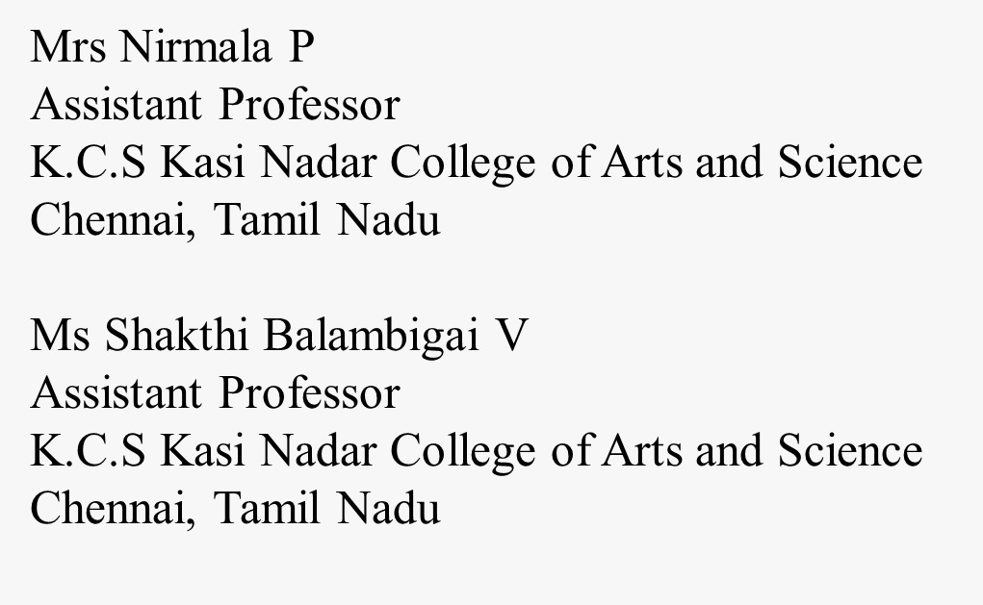
REFERENCE

